Slide 1
MILLIPLEX Mouse Metabolic Hormone Expanded Panel (MMHE-44K)
Kotz Lab Meeting
05/15/25
Audrey Daugherty

Slide 2
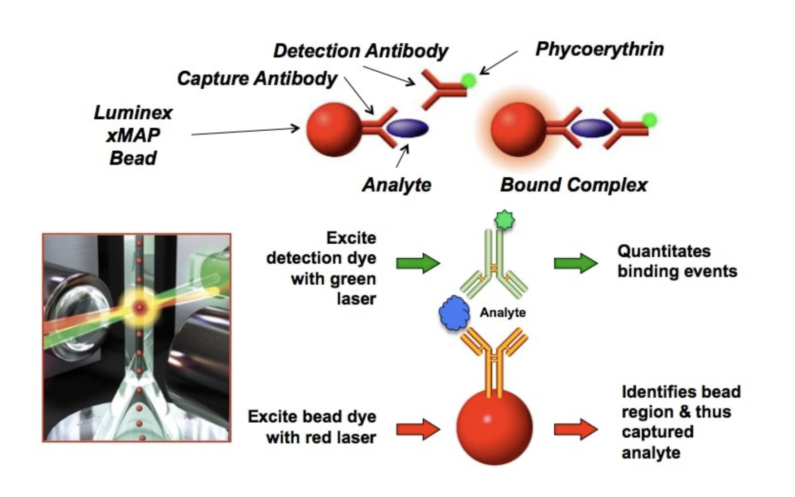
Luminex (xMAP) Technology

Slide 3
Experimental Details
Analytes:
Amylin (Active)
C-Peptide 2
Ghrelin (Active)
GIP (Total)
GLP-1 (Total
Glucagon
IL-6
Insulin
Leptin
MCP-1/CCL2
PP
PYY
Resistin
Secretin
TNFa
NZO Peak of Obesity (n=10 + n=9)
AdLib LFD
11-12 weeks
NZO Maintenance of Obesity (n=10)
AdLib LFD
6 weeks
NZO Restricted group after 20% BW(n=9) Reduction
Restricted LFD feedings
It was recommended to have protease inhibitors added to the blood for the following measurements; we did not do that this time:
GLP-1
Amylin
Glucagon
Active Ghrelin

Slide 4
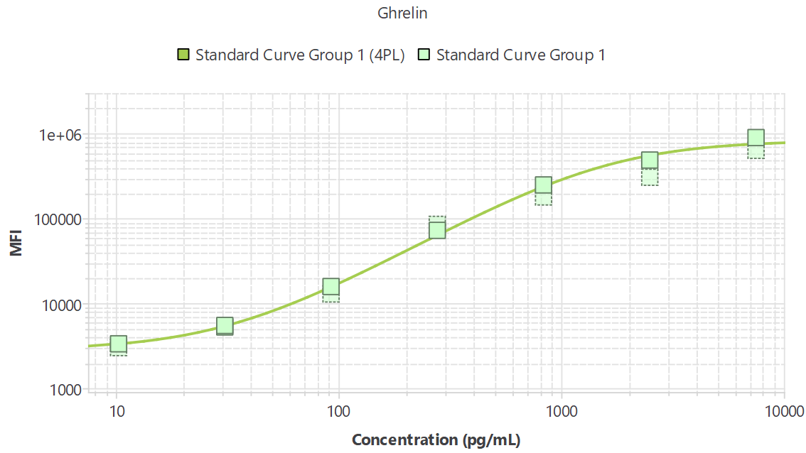
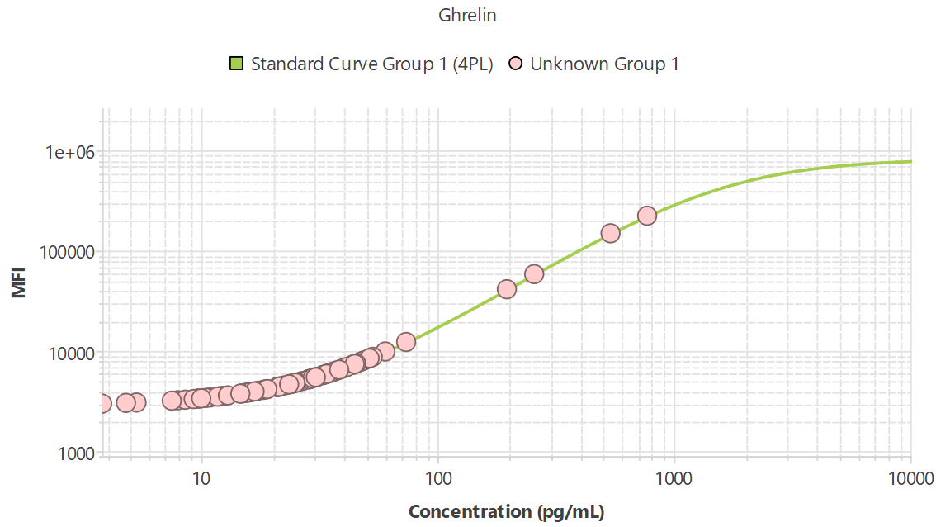
R²=0.97
Unpaired Student’s T-test
Ordinary One-way ANOVA with Multiple Comparisons
Any value <9.48 (pg/mL) is below the standard curve (2 samples)

Slide 6
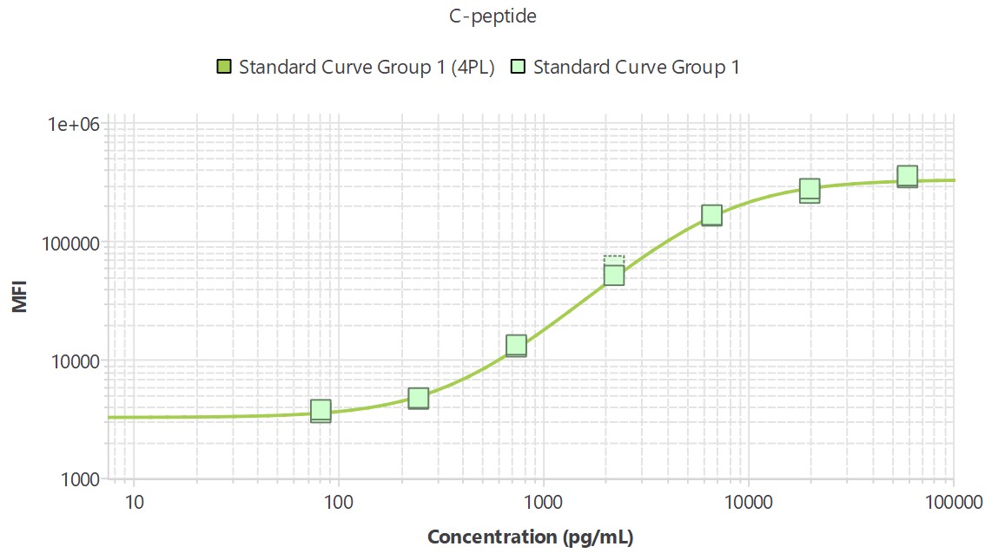
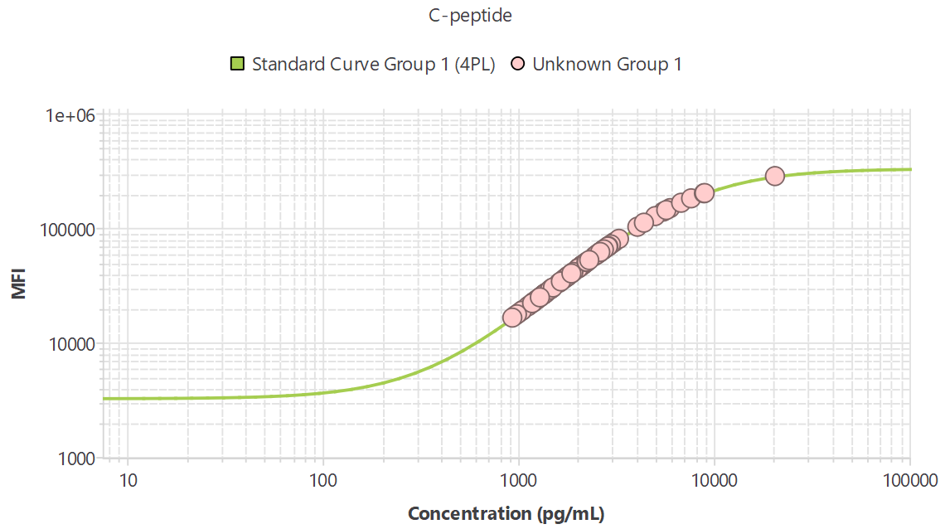
R²=0.99
Unpaired Student’s T-test
Ordinary One-way ANOVA with
Multiple Comparisons
3 outliers removed by ROUT Q=1%
outlier test

Slide 8
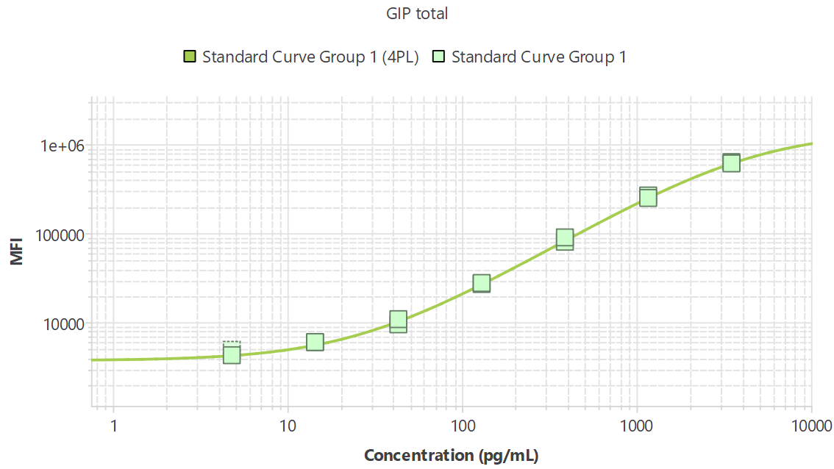
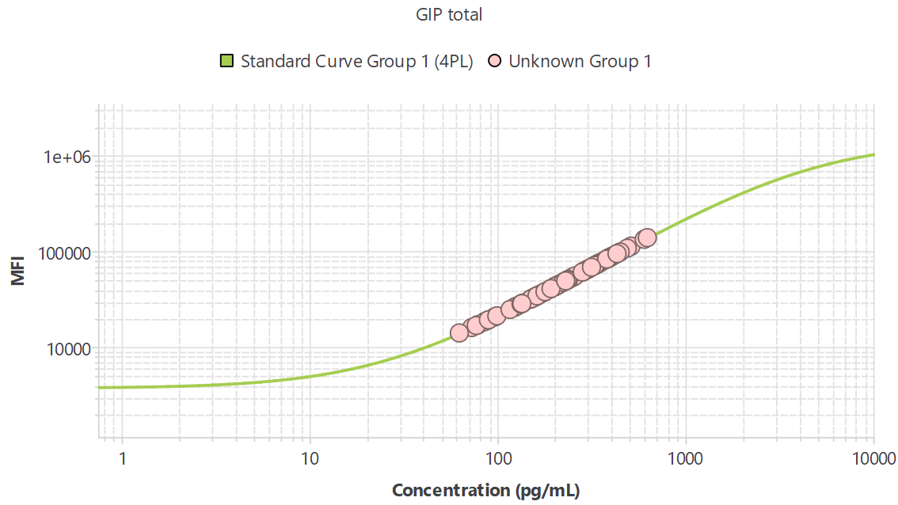
R²=1.00
Unpaired Student’s T-test
Ordinary One-way ANOVA with
Multiple Comparisons
1 outlier removed by ROUT Q=1%
outlier test

Slide 10
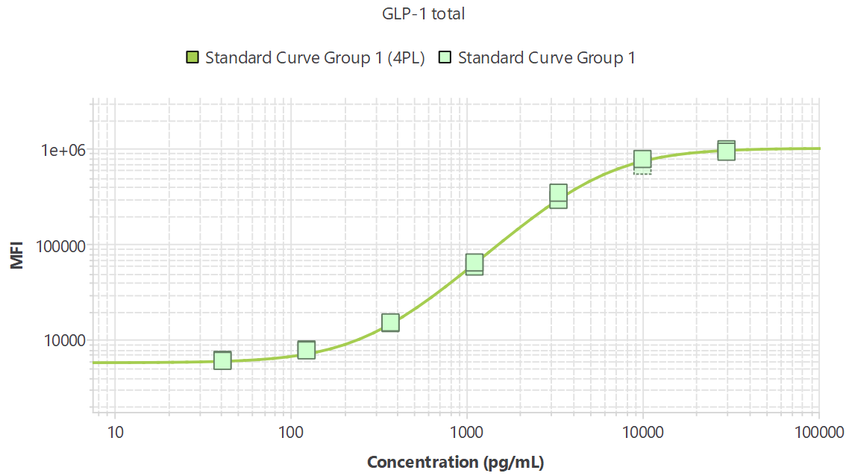
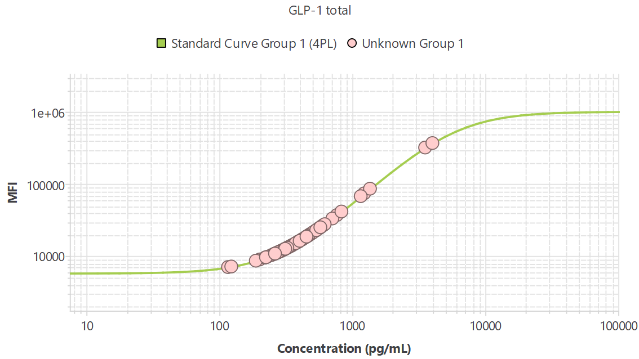
R²=1.00
Unpaired Student’s T-test
Ordinary One-way ANOVA with
Multiple Comparisons

Slide 12
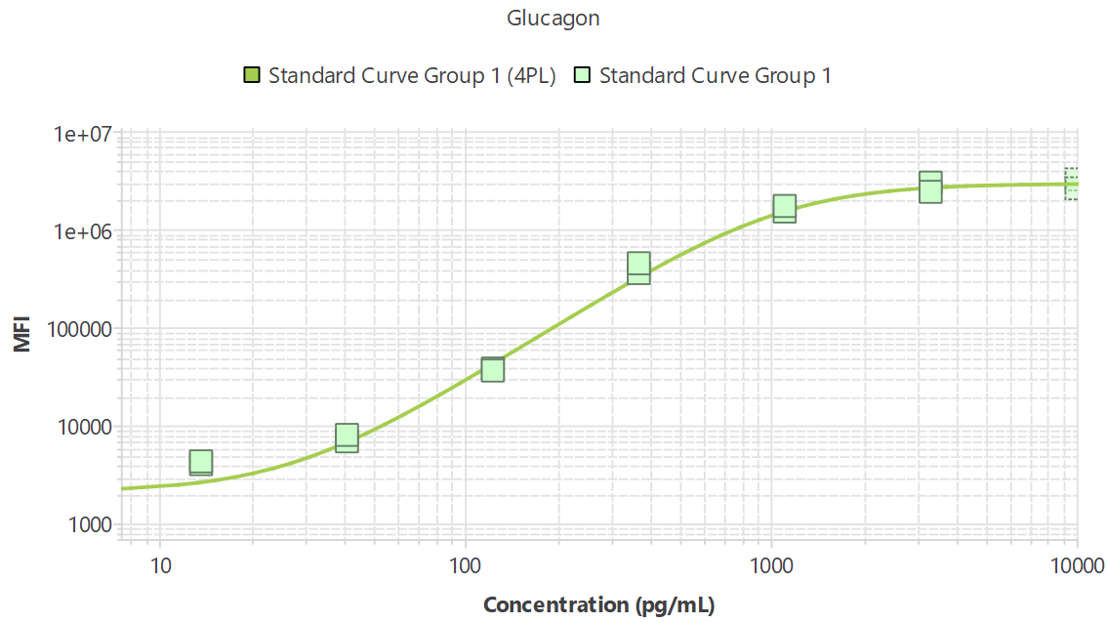
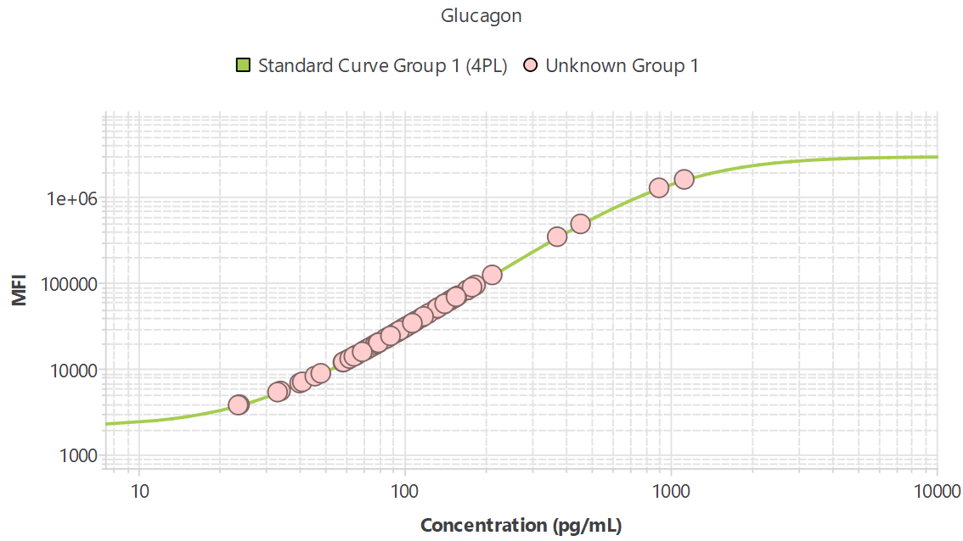
R²=0.98
Unpaired Student’s T-test
Ordinary One-way ANOVA with
Multiple Comparisons

Slide 14
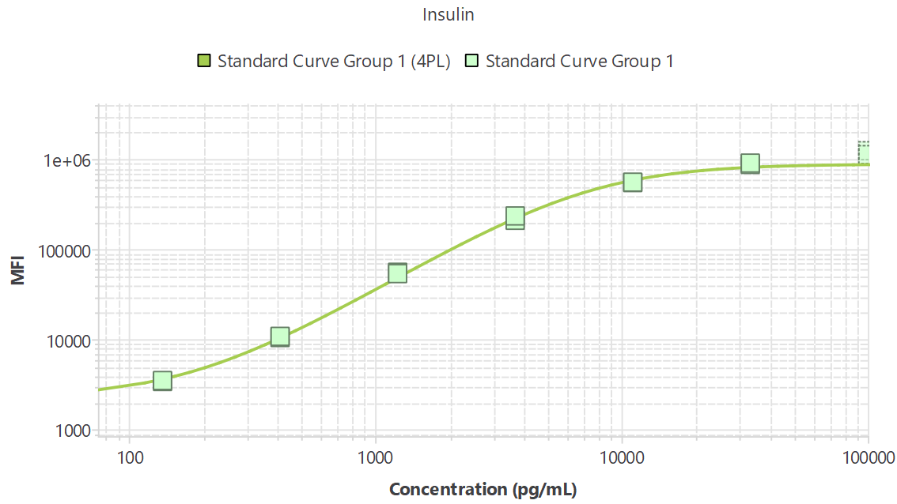
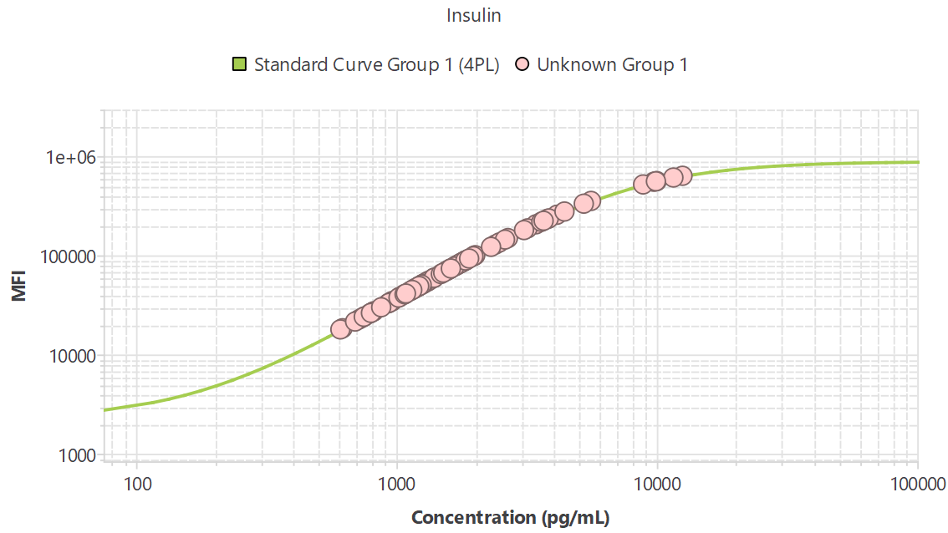
R²=0.99
Unpaired Student’s T-test
Ordinary One-way ANOVA with
Multiple Comparisons
4 outliers removed by ROUT Q=1%
outlier test

Slide 16
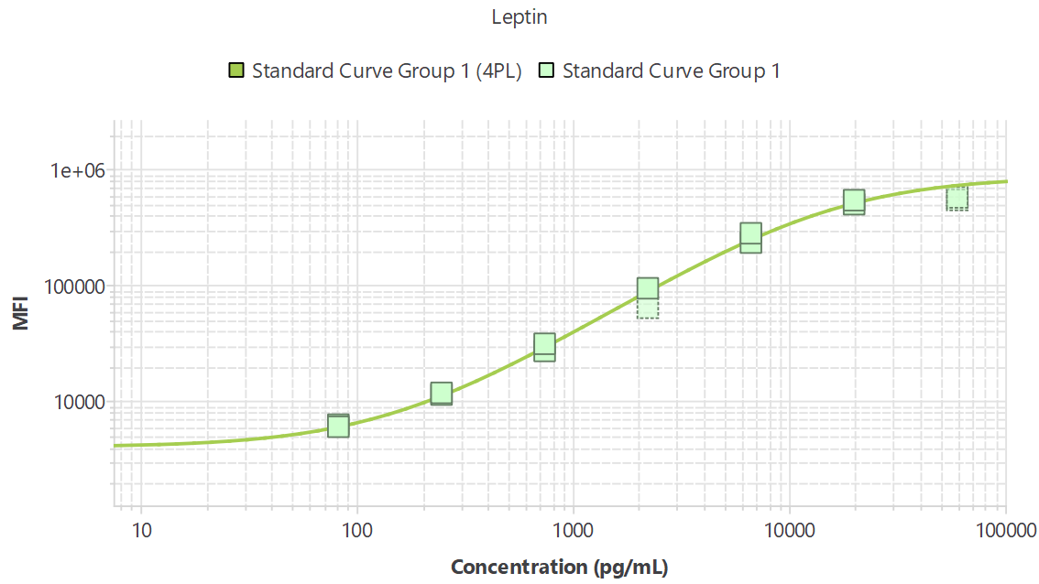
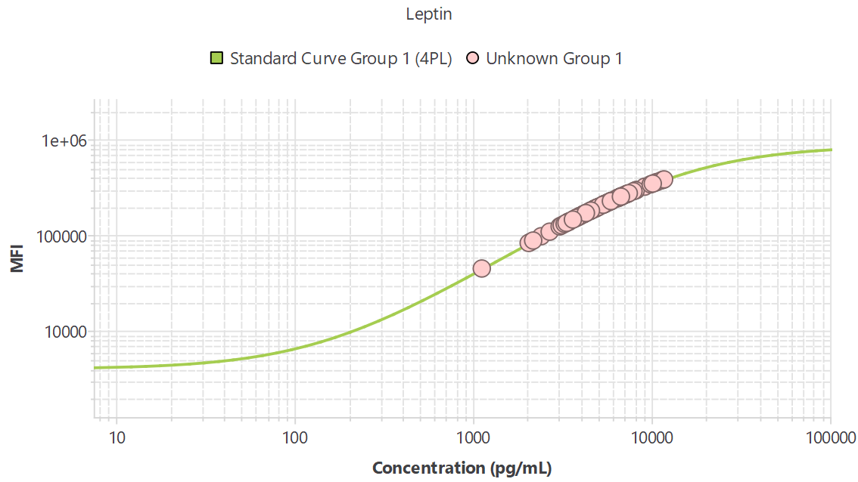
R²=1.00
Unpaired Student’s T-test
Ordinary One-way ANOVA with
Multiple Comparisons

Slide 18
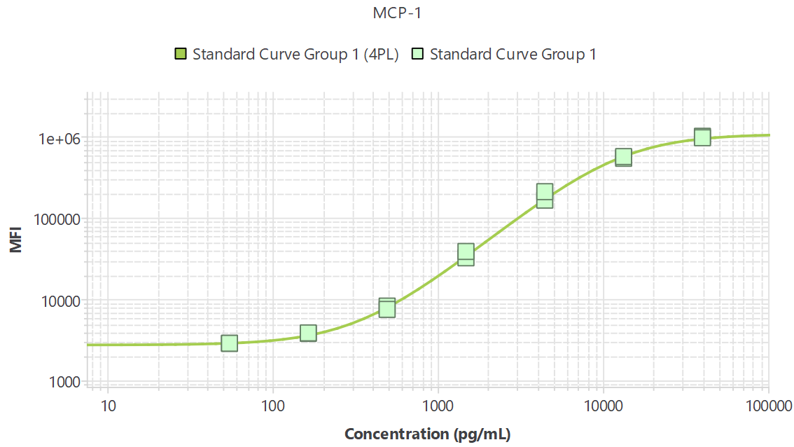
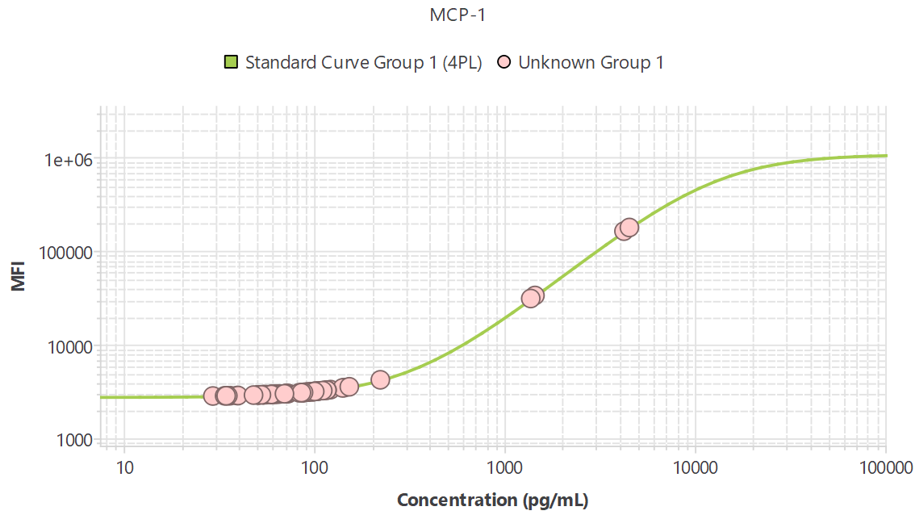
R²=1.00
Unpaired Student’s T-test
Ordinary One-way ANOVA with
Multiple Comparisons
(17 samples not detectable in the duplicates)

Slide 20
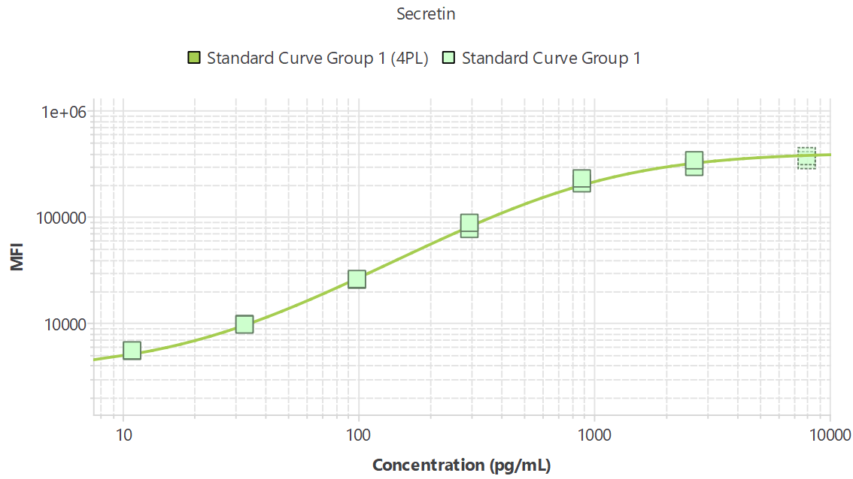
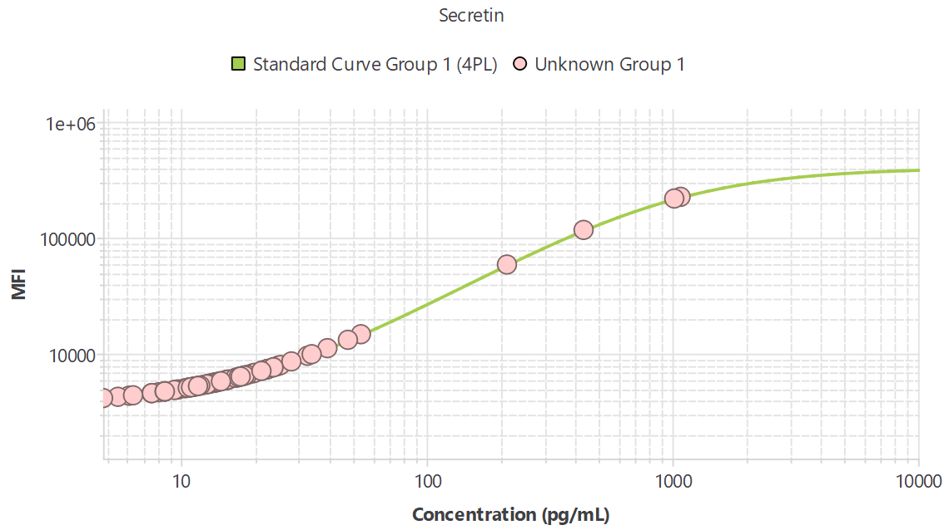
R²=0.99
Unpaired Student’s T-test
Ordinary One-way ANOVA with
Multiple Comparisons
Any value <12.76 (pg/mL) is below the standard curve (14 samples)

Slide 22
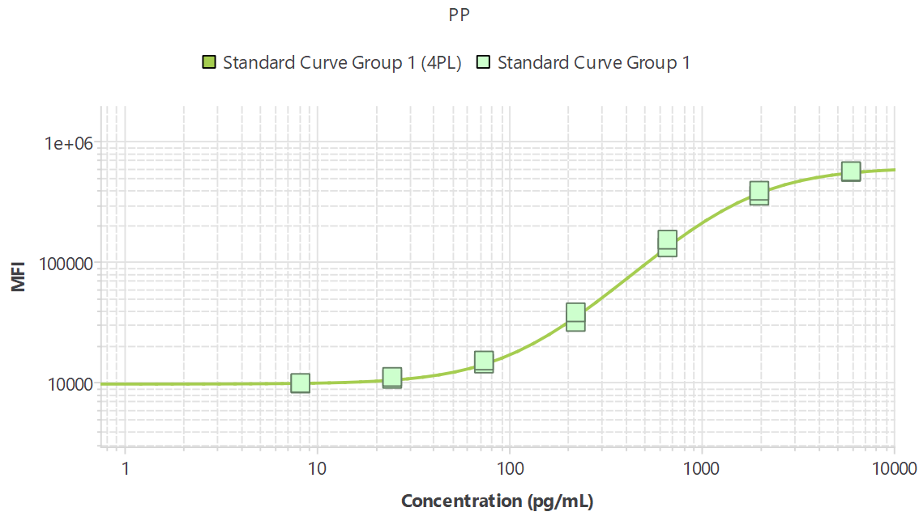
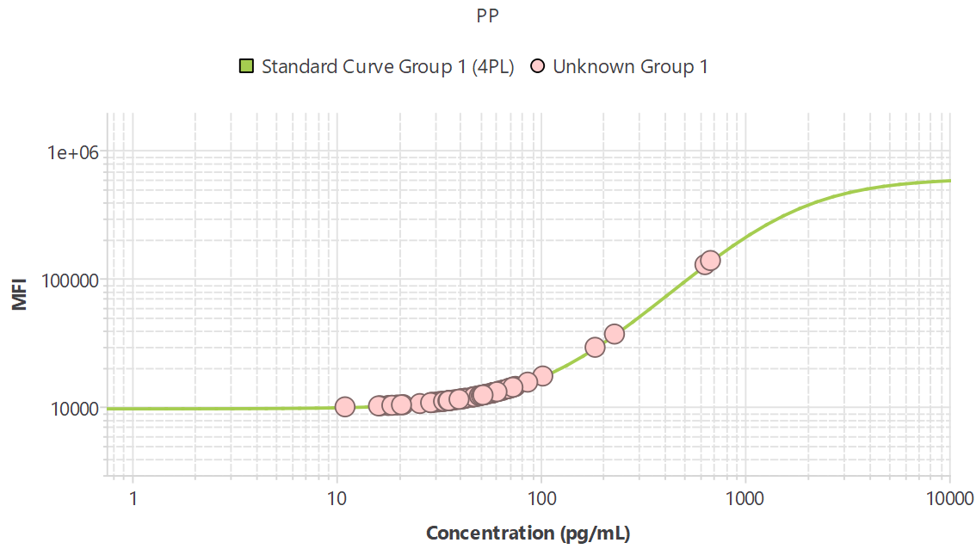
R²=1.00
Unpaired Student’s T-test
Ordinary One-way ANOVA with
Multiple Comparisons
Any value <30.14 (pg/mL) is below the standard curve (4 samples)
(3 samples not detectable)

Slide 24
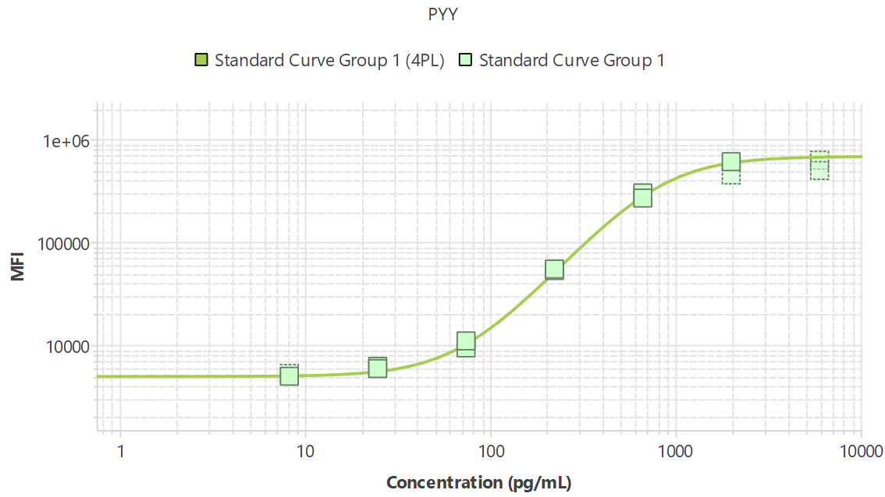
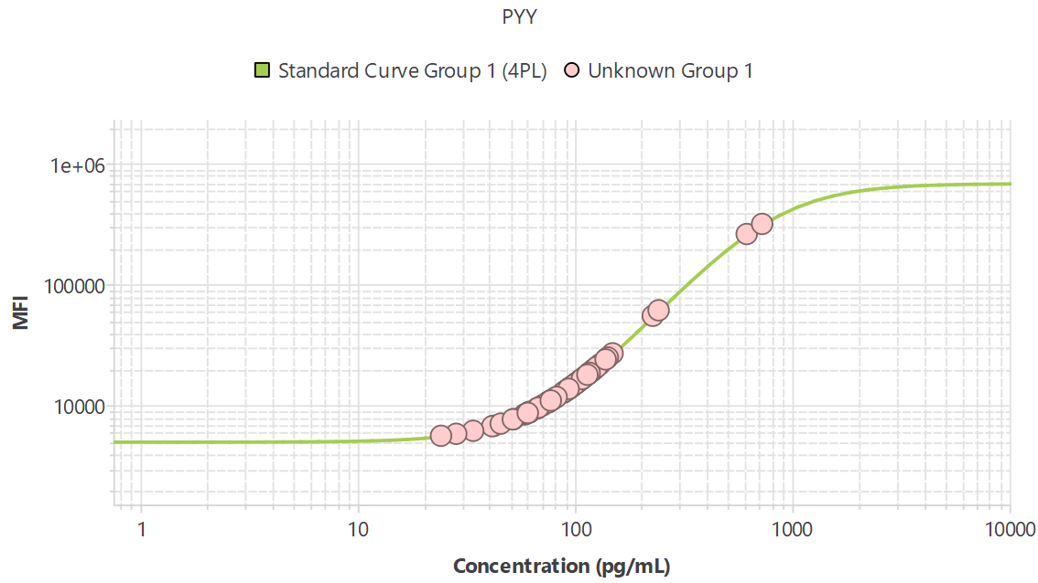
R²=1.00
Unpaired Student’s T-test
Ordinary One-way ANOVA with
Multiple Comparisons
Any value <32.54 (pg/mL) is below the standard curve (1 sample)

Slide 26
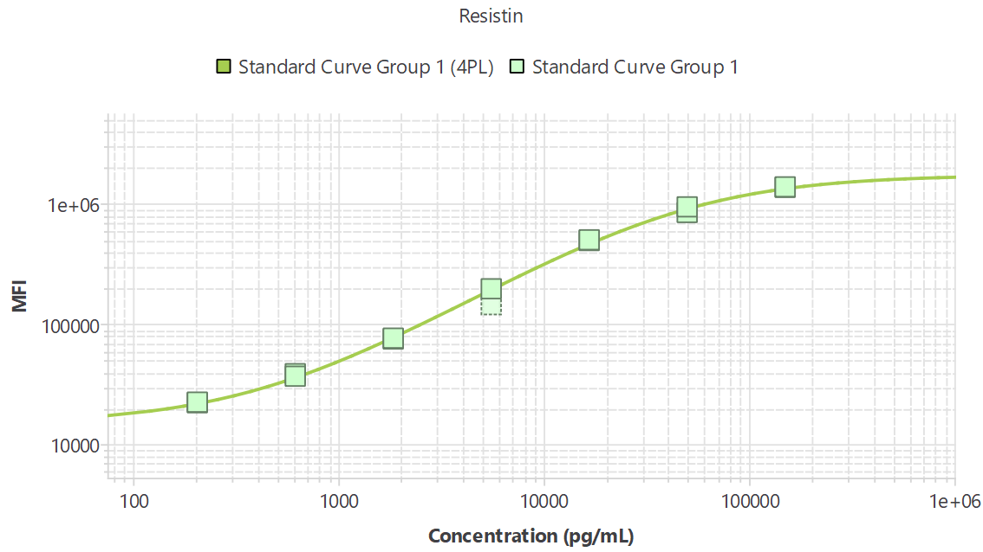
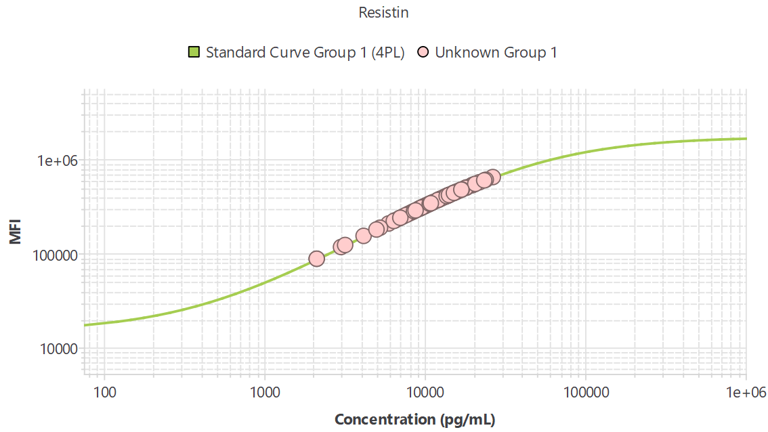
R²=1.00
Unpaired Student’s T-test
Ordinary One-way ANOVA with
Multiple Comparisons
Resistin QC Failed

Slide 28
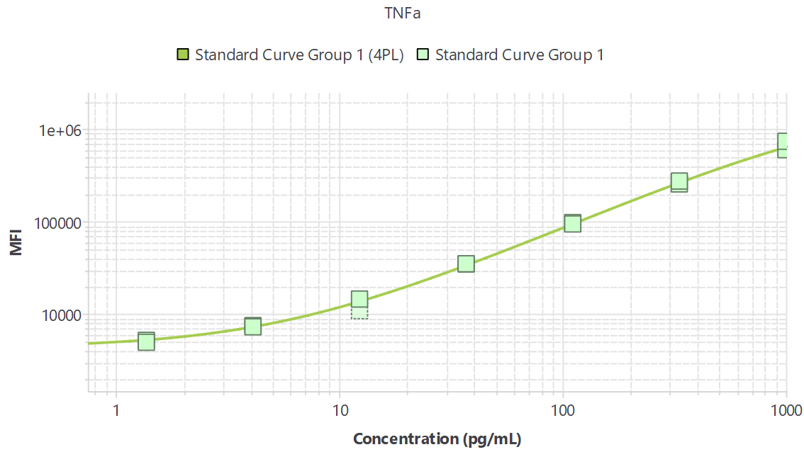
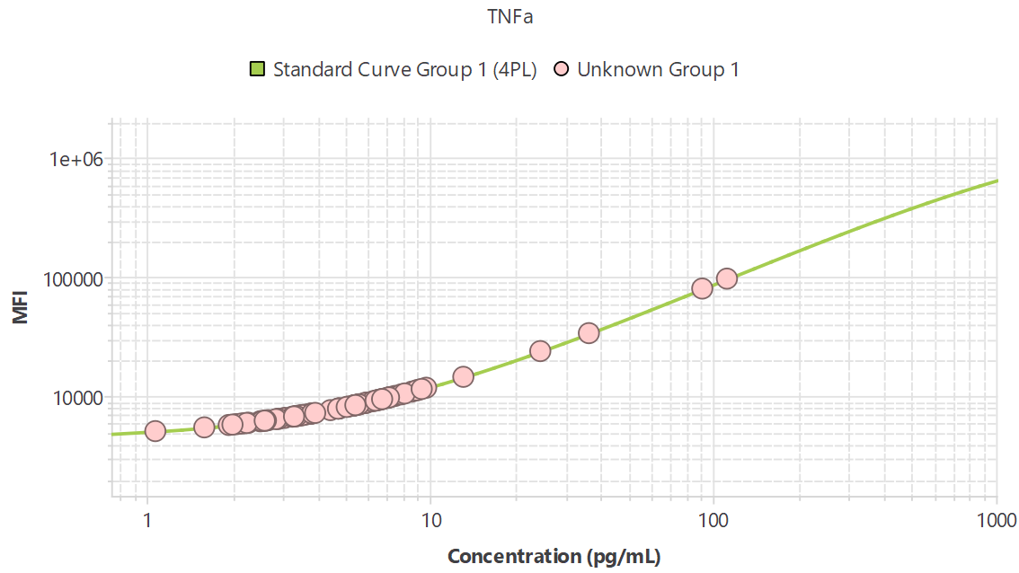
R²=0.99
Unpaired Student’s T-test
Ordinary One-way ANOVA with
Multiple Comparisons
(2 samples not detectable)

Slide 30
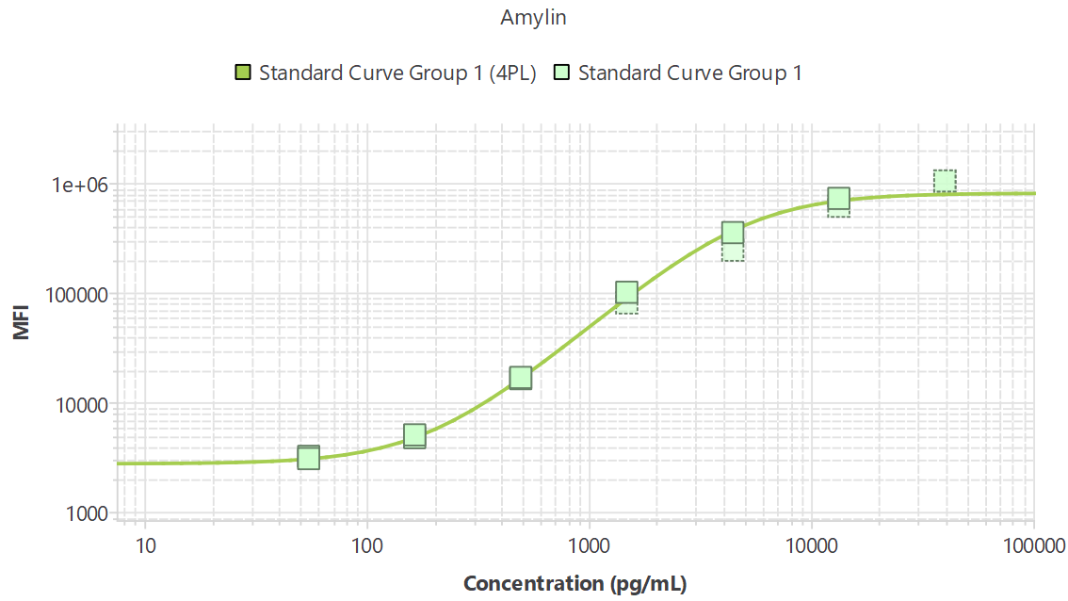
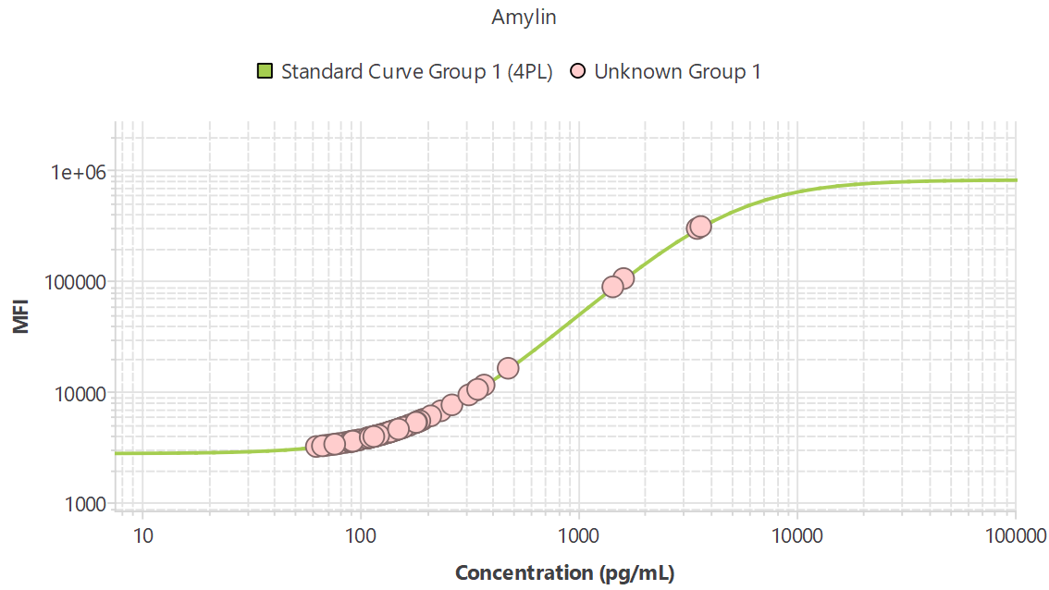
R²=1.00
Unpaired Student’s T-test
Ordinary One-way ANOVA with
Multiple Comparisons
1 outlier removed by ROUT Q=1%
outlier test

Slide 32
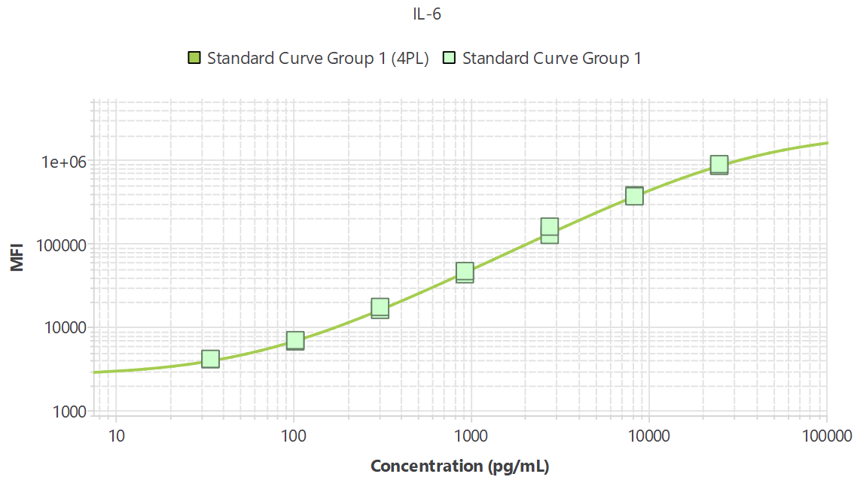
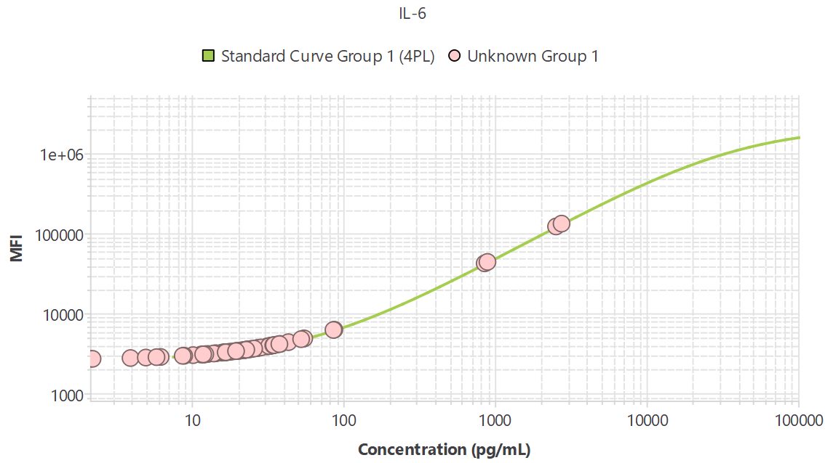
R²=1.00
Unpaired Student’s T-test
Ordinary One-way ANOVA with
Multiple Comparisons
Any value <32.79 (pg/mL) is below the standard curve (33 samples)
(2 samples not detectable)

